Slide 1
QUIZ MANAGEMENT SYSTEM
Rohith R
2023246038
MTech IT

Slide 2
OBJECTIVES
To create questions for quiz
To set timer
To evaluate the quiz
To display the final score
To view the other Participants

Slide 3
TOOLS
Node.js and npm
Vs Code
Redux ToolKit
MongoDB
Express

Slide 4
FUNCTIONALITIES
Quiz Management:
Create, update, and delete quizzes.
Specify the correct answer(s) for each question.
Quiz Taking:
Display a list of available quizzes.
Allow users to select and take a quiz.
Timer functionality for quizzes.

Slide 5
RESPONSIVE DESIGN:
Make the application mobile-friendly.
SCORING AND RESULTS:
Calculate and display the user's score.
Store and display historical quiz results for users.
USER PROFILES:
Display user details.
Show a history of quizzes taken.

Slide 6
INDEX PAGE (main.js)
Existing users can login with to take the quiz.
On successful login the candidate is forwarded to the question page.

Slide 7
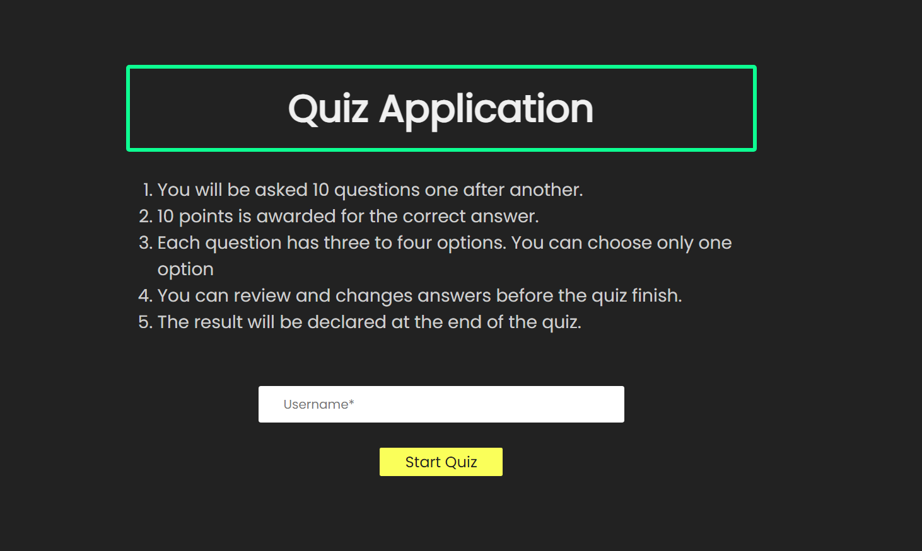
OUTPUT

Slide 8
QUESTIONS
data.js and questions.js
Data.js files have set of questions
Questions.js displays the question which is retrieve from fetchquestion.js along with the options for that question
Fetchquestion.js
This page calls the set of events like move previous question and move next question with the help of useEffect. UseEffect is mainly used to execute the set of logic after the execution of the functional component.

Slide 9
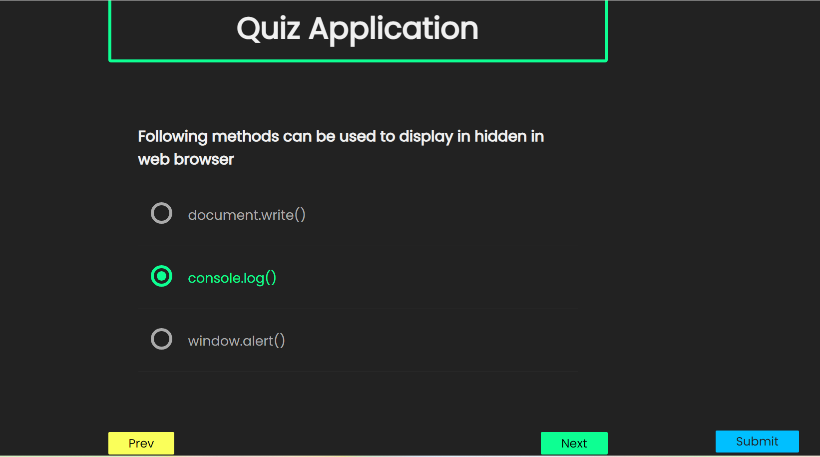
OUTPUT

Slide 10
EVALUATE
Helper.js
This file calculate the marks for the question. Each question carries 10 mark and finally gives the result whether the user pass or fail for the quiz.
setresult.js
This file update the result for the user using dispatch. It will take the current state/function, which means the current state of our application and reducer will also take action.

Slide 11
REDUX
Result_reducer.js
This file consists function definition for name ,marks, exam result after computation the values are fed to result.js that file displays the content that passed from this sile
Question_reducer.js
This file consists set of events function definition for movenextquestion, prev question

Slide 12
RESULT
Result.js
This file displays the user name, marks, exam result, total questions, user attempts with the help of result_reducer.js
resulttable.js
This page displays the same as result.js file in addition of it displays the overall users who are all attend the quiz exam so far with their details.

Slide 13
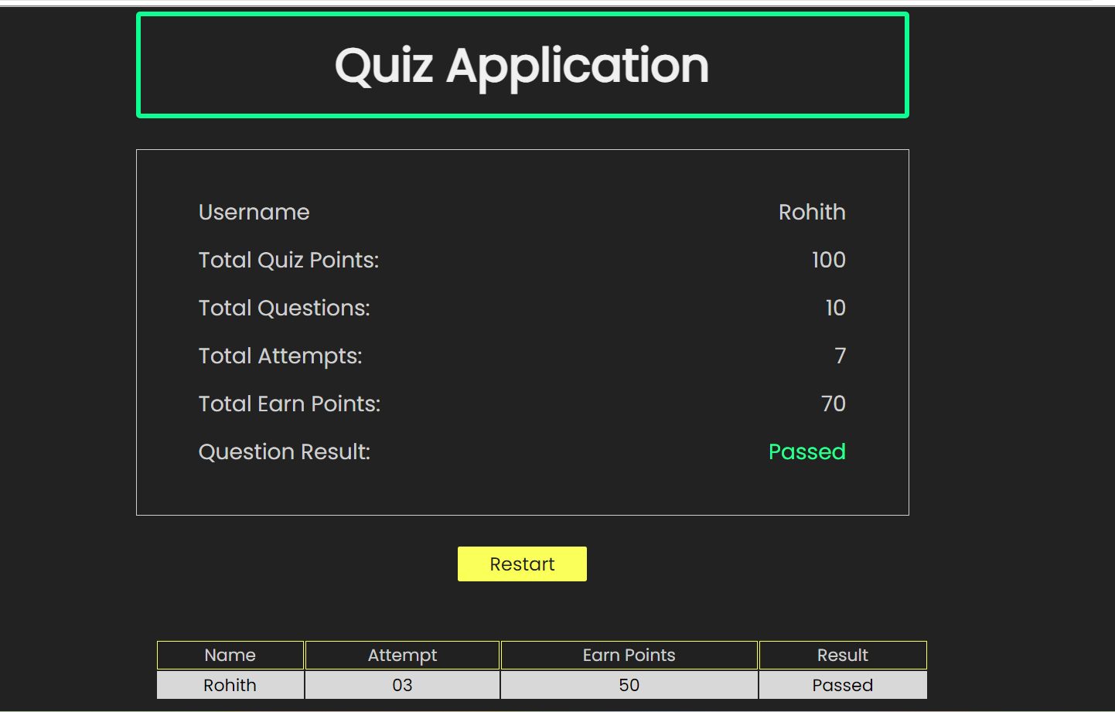
OUTPUT

Slide 14
INDEX
Store.js
Combine both question and result reducer to make as root and fed into index.js
App.js
This file routes to main page,quiz page and result page overall js file bundling to sing root file that fed to index.js that renders the app component

Slide 15
CONNECTION
Conn.js
To get port no and mongodb cloud db url(including name and password)
Route.js
In express tool we import the router to get the routes API HTTP(post, get, put, delete). Each and every set of methods some set of actions executed, which can insert the user record and delete or truncate the user record.

Slide 16
CONTROLLER
Controller.js
This file contains set of mondoDB functions like insert,select,create,delete ….
Server.js
This server.js start the server only when we have valid connection otherwise it cant connect to server.

Slide 17
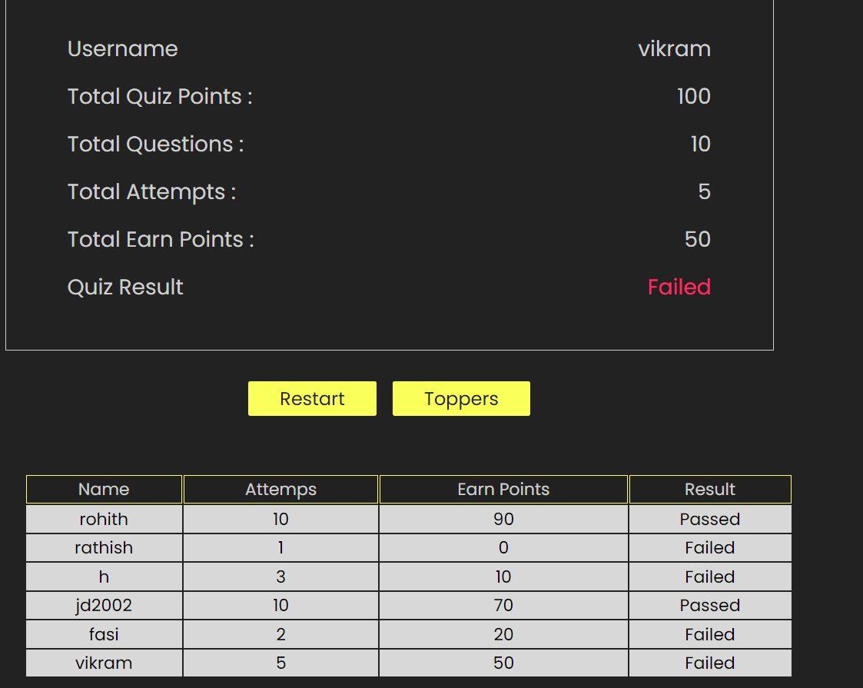
OUTPUT

Slide 18
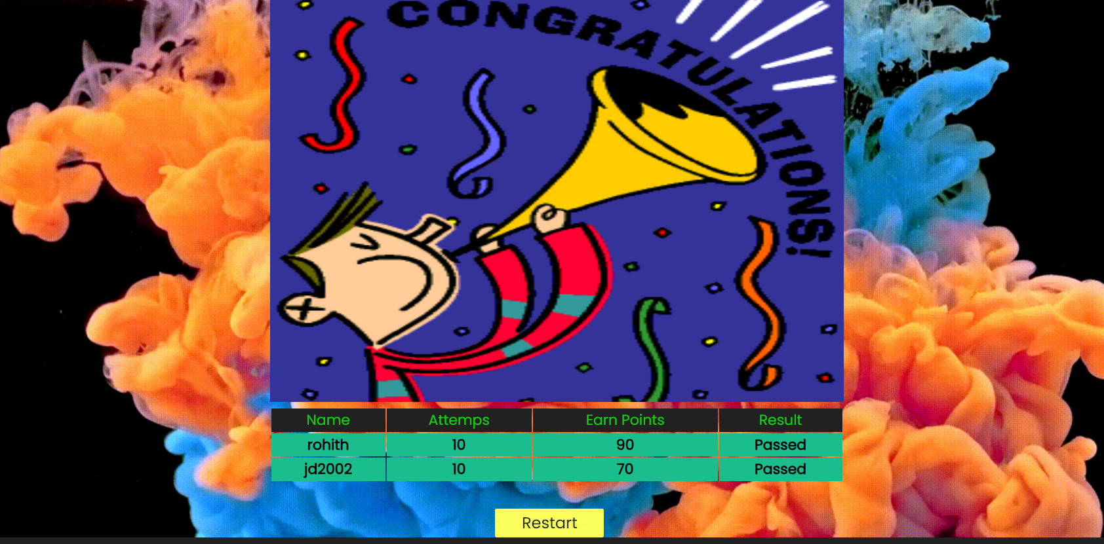
OUTPUT

Slide 19
THANK YOU

